Slide 1
ENERGY AND ENVIORNMENT INTERACTIONS II part

Slide 2
NUCLEAR ENERGY

Slide 3
NUCLEAR ENERGY
Synonymous with atomic energy
The nucleus of an atom is the source of nuclear energy.
When the nucleus splits (fission), nuclear energy is released in the form of heat energy and light energy.
Nuclear energy is also released when nuclei collide at high speeds and join (fuse).

Slide 4
FISSION
Fission occurs when an atom’s nucleus splits apart to form two or more different atoms.
The most easily fissionable elements are the isotopes of U 235 and Pu 239.
When fissionable elements are flooded with neutrons causing the elements to split, they form new radioactive elements and release extra neutrons that create a chain reaction if more fissionable material is present.
While Uranium, atomic number 92, is the heaviest naturally occurring element, many other elements can be made by adding protons and neutrons with particle accelerators or nuclear reactors.
In general, the fission process uses higher atomic numbered elements.
Notes:
U: Uranium, Pu: Plutonium

Slide 5
FUSION
Fusion is the combining of one or more atoms usually isotopes of hydrogen, which are deuterium and tritium.
Atoms naturally repel each other so fusion is easiest with these lightest atoms.
To force the atoms together it takes extreme pressure and temperature, this can be produced by a fission reaction.
The sun’s energy is produced from a nuclear fusion reaction in which hydrogen nuclei fuse to form helium nuclei.

Slide 6
BRIEF HISTORY
Nuclear energy was first discovered in 1934 by Enrico Fermi.
The first nuclear bombs were built in 1945 as a result of the infamous Manhattan Project.
The first plutonium bomb, code-named Trinity, was detonated on July 16, 1945 in New Mexico, USA.
On August 6th 1945, the first uranium bomb was detonated over Hiroshima. Three days later a plutonium bomb was dropped on Nagasaki. There are over 200,000 deaths associated with these detonations.
Electricity wasn’t produced with nuclear energy until 1951.

Slide 7
CHICAGO PILE 1, DECEMBER 2, 1942
FIRST SUCESSFUL NUCLEAR REACTOR

Slide 8
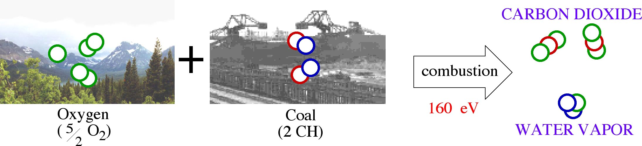
ENERGY FROM FOSSIL FUELS
Fossil Fuel (Coal) Energy Density: 2.9 x 10⁷ J/kg
Fuel Consumed by 1000-MW_{e} Plant: 7,300,000 kg/day
Global Coal Consumption: 6.8 billion tons
1 eV = 1.6 x10⁻¹⁹ J

Slide 9
ENERGY FROM NUCLEAR FISSION
Fission Fuel Energy Density: 8.2 x 10¹³ J/kg
Fuel Consumed by 1000-MW_{e} Plant: 3.2 kg/day

Slide 10
ENERGY FROM NUCLEAR FUSION
Fusion Fuel Energy Density: 3.4 x 10¹⁴ J/kg
Fuel Consumed by 1000-MW_{e} Plant: 0.6 kg/day

Slide 11
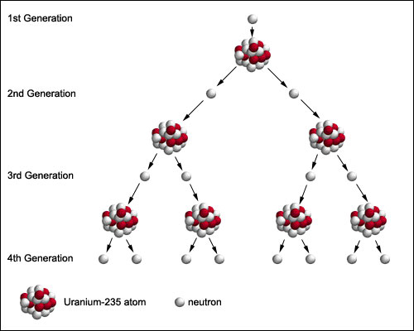
CHAIN REACTION
Neutrons are emitted when ²³⁵U undergoes fission
These neutrons are then available to trigger fission in other nuclei and the process repeats.
If the process is controlled it is termed as chain reaction and used for nuclear power
if uncontrolled, a violent explosion occurs (used for nuclear weapons, 1 g of ²³⁵U can release energy equal to 15 Tonnes of TNT)
Nitroglycerine-Dynamite? Alfred Nobel

Slide 12
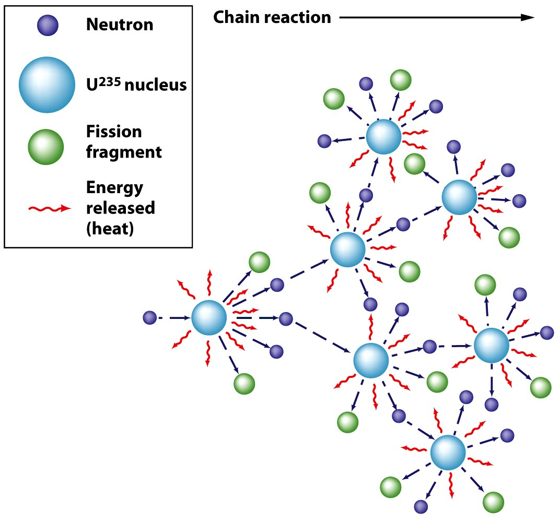
E = mc²

Slide 13
Fission Reactors
Splitting of U235 by neutron bombardment
Reaction produces neutrons, fission fragments and heat.
Starts a chain reaction
U-238 does not undergo fission
Natural Uranium contains U235 (0.72%) and U238(99.28%)
Steam produced runs a turbine coupled with alternator to generate electricity
Similar to coal/oil/gas burning power plants

Slide 14
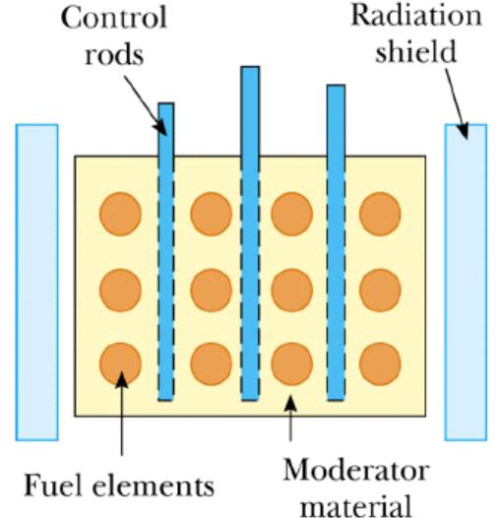
BASIC REACTOR DESIGN
The furnace in which the controlled fission of nuclear fuel takes place is called reactor or atomic reactor.
Fuel elements consist of enriched ²³⁵U (natural uranium contains 0.72% ²³⁵U and 99.28% ²³⁸U)
²³⁸U never undergoes fission
Control rods absorb the neutrons
Moderator material helps to slow down the neutrons

Slide 15
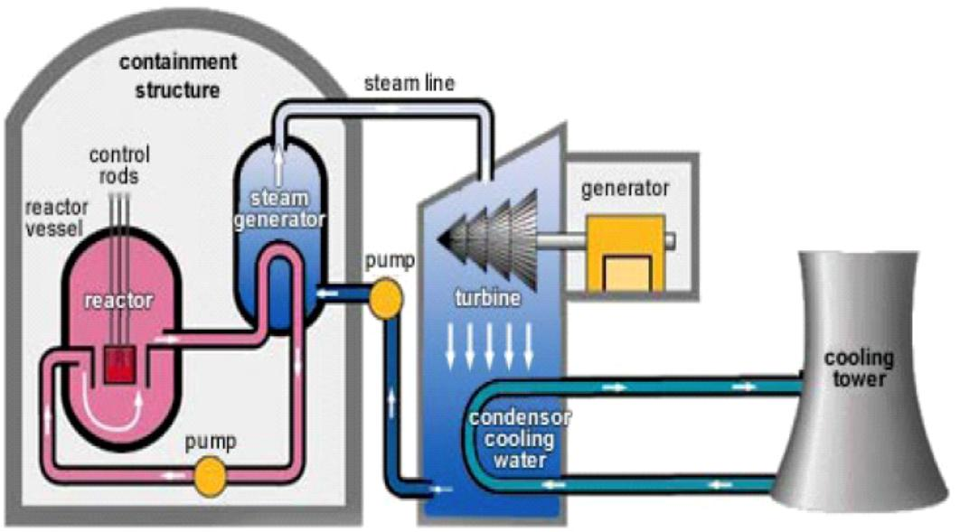
NUCLEAR FISSION REACTOR

Slide 16
Problems with Nuclear Power
Uranium mines and mills produce radioactive waste material that can pollute the environment
U-235 enrichment and fabrication of fuel assemblies also produces waste materials.
Site selection and construction controversial.
Power plants also the site of past accidents or partial meltdowns.
Handling and disposal of waste
Decommissioning expensive
Terrorists could collect plutonium for bomb

Slide 17
Nuclear Power Plant Accidents

Slide 18
Three Mile Island
Occurred on March 28, 1979 near Harrisburg, PA
Malfunction of a valve resulted in partial core meltdown
Intense radiation released to interior of containment structure
Small amount of radiation released into environment
Because long-term chronic effects of exposure to low levels of radiation are not well understood, the effects of TMI difficult to estimate.
Major impact of the incident was fear.

Slide 19
Chernobyl
Occurred on April 26, 1986
Worst accident in history of nuclear power generation
Failure in cooling waters
Reactor overheated melting the uranium fuel
Explosions removed top of building
Fires produced a cloud of radioactive particles
30 km zone surrounding Chernobyl evacuated
City of Prypyat, pop. 48,000 at time of accident, now a ghost city.
Thyroid cancer increased in Belarus, Ukraine and the Russian Federation
Trees and vegetation damaged
Ultimately responsible for 16,000 deaths

Slide 20
Fukushima Daiichi
Occurred on March 11, 2011
Second Worst accident in history of nuclear power generation
Failure in cooling water supply due to tsunami
Three reactor overheated
Hydrogen-air explosion
37 were injured mildly
2 taken to hospital for serious injuries
No casualty
Loss of the power plant

Slide 21
Future of Nuclear Energy
Advocates argue that nuclear power is good for the environment
It does not produce potential global warming through release of carbon dioxide.
It does not cause acid rain.
If breeder reactors are developed the amount of fuel (Thorium- India got maximum reserves) will be greatly increased.
Arguments for standardization
Safer and smaller plants to provide more energy

Slide 22
Future of Nuclear Energy
Argument against
Based on political and economic consideration
Uncertainty of safety issues
Known reserves would be used up quickly
May be a path to nuclear weapons

Slide 23
FUSION

Slide 24
FUSION IN NATURE
All stars generate energy through fusion
The Sun, along with about 90% of other stars, fuses hydrogen
Some “older” stars fuse heavier elements
Two conditions must be met before fusion can occur in a star
The temperature must be high enough
The density of the nuclei must be high enough to ensure a high rate of collisions

Slide 25
FUSION REACTORS
Energy releasing fusion reactions are called thermonuclear fusion reactions or simply thermonuclear reactions.
A great deal of effort is being directed at developing sustained and controlled thermonuclear reactions.
A thermonuclear reactor that can deliver a net power output over a reasonable time interval is not yet a reality.

Slide 26
ATOMIC POWER AND INDIA
India is a quickly advancing an active nuclear power program.
It is expected to have 20 GW of nuclear capacity by 2020, though they currently stand as the 9th in the world in terms of nuclear capacity.

Slide 27
Currently, twenty-one nuclear power reactors have a total install capacity of 5,780 MW
Power station | Operator | State | Type | Units | Total capacity (MW)
Kaiga | NPCIL | Karnataka | PHWR | 220 x 4 | 880
Kakrapar | NPCIL | Gujarat | PHWR | 220 x 2 | 440
Madras | NPCIL | Tamil Nadu | PHWR | 220 x 2 | 440
Narora | NPCIL | Uttar Pradesh | PHWR | 220 x 2 | 440
Rajasthan | NPCIL | Kota Rajasthan | PHWR | 100 x 1 200 x 1 220 x 4 | 1180
Tarapur | NPCIL | Maharashtra | BWR PHWR | 160 x 2 540 x 2 | 1440
Kudankulam | NPCIL | Tamil Nadu | VVER-1000 | 1000 x 1 | 1000
 |  |  | Total | 21 | 5780

Slide 28
Projects under construction
Power station | Operator | State | Type | Units | Total capacity (MW) | Expected Commercial Operation
Madras | Bhavini | Tamil Nadu | PFBR | 500 x 1 | 500 | March 2015
Kakrapar Unit 3 and 4 | NPCIL | Gujarat | PHWR | 700 x 2 | 1400 | Unit 3: June 2015, Unit 4: December 2015
Rajasthan Unit 7 and 8 | NPCIL | Rajasthan | PHWR | 700 x 2 | 1400 | Unit 7: June 2016, Unit 8: December 2016
Kudankulam Unit 2 | NPCIL | Tamil Nadu | VVER-1000 | 1000 x 1 | 1000 | May 2015
 |  |  | Total | 6 | 4300

Slide 29
Proposed Projects
Power station | Operator | State | Type | Units | Total capacity (MW)
Gorakhpur | NPCIL | Haryana | PHWR | 630 x 4 | 2,800
Chutka | NPCIL | Madhya Pradesh | PHWR | 700 x 2 | 1400
Mahi Banswara | NPCIL | Rajasthan | PHWR | 700 x 2 | 1400
Kaiga | NPCIL | Karnataka | PHWR | 700 x 2 | 1400
Madras | NPCIL | Tamil Nadu | FBR | 500 x 2 | 1000
Site to be decided |  |  | AHWR | 300 x 1 | 300
Kudankulam |  | Tamil Nadu | VVER-1000 | 1000 x 2 | 2000
Jaitapur |  | Maharashtra | EPR | 1650 x 6 | 9900
Kovvada |  | Andhra Pradesh | ESBWR | 1594 x 6 | 9564
Mithi Virdi (Viradi) |  | Gujarat | AP1000 | 1100 x 6 | 6600
 |  |  | Total | 33 | 33564

Slide 30
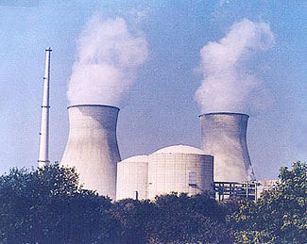
NARORA ATOMIC POWER STATION, UNITS 1 & 2, 220 MW EACH

Slide 31
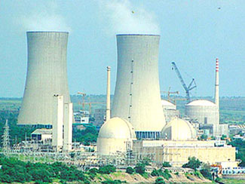
RAJASTHAN ATOMIC POWER STATION, UNITS 3 & 4, 220 MW EACH

Slide 32
Example 1
(P/H)
A thermal power plant of 2000 MW capacity is using coal having a heating value of 28.65 MJ/kg. Determine the amount of the coal in tonnes being used by this plant on an annual basis assuming that the plant runs for 325 days in a year and overall conversion efficiency of the plant is 34.56%.
If the above plant is polluting the environment and a decision is taken to replace it with an atomic power plant of the same capacity. Determine the mass of U235 fuel rods required annually to run this plant. U235 fuel rods comprise of 95.55% of U238. This plant may be assumed to run for 325 days in a year with an thermal energy conversion into electricity to be 45.54%.

Slide 33
SOLAR ENERGY

Slide 34
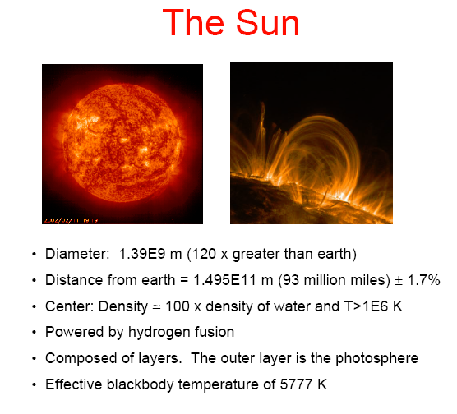
SUN
Energy received from the sun in 30 days exceeds total energy available in fossil fuels

Slide 35
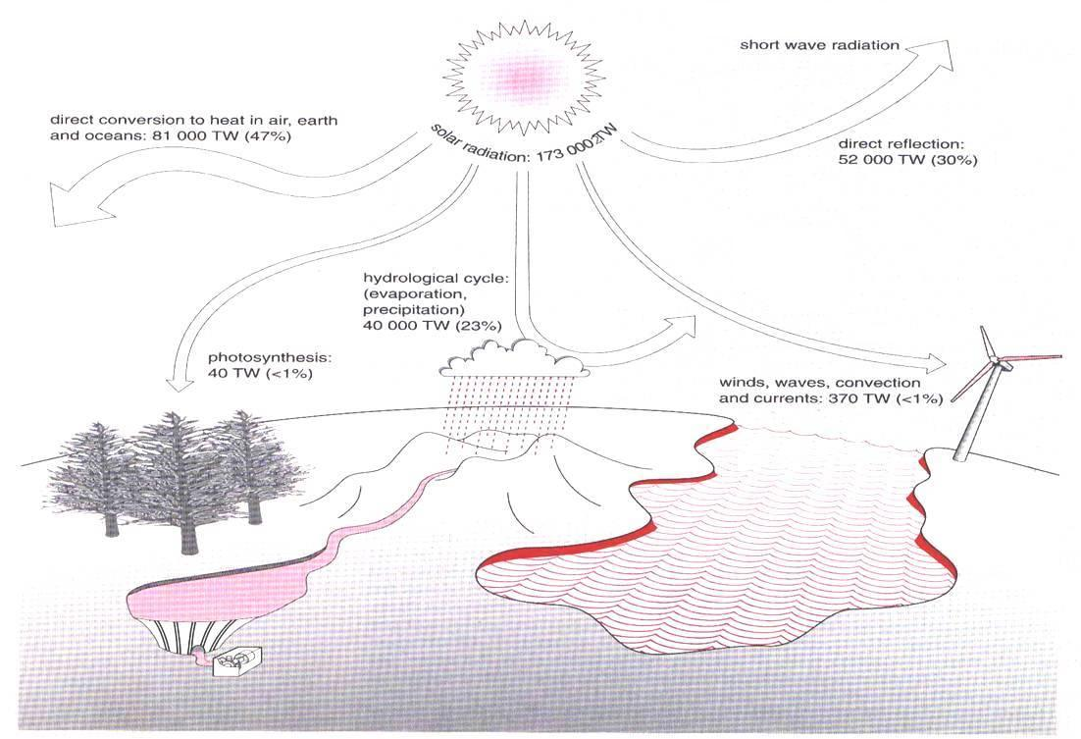
SOLAR ENERGY
Sun is the only source of all renewable energy

Slide 36
SOLAR RADIATION
Energy from the sun reaches earth’s surface in the form of solar radiation.
The Sun is a sphere of intensely hot gaseous matter, continuously generating heat by thermo-nuclear fusion reactions, which convert hydrogen atoms to helium atoms.
This energy radiated from the sun in all directions and a very small fraction of its reaches the earth.
The maximum intensity of solar radiation known as solar constant which is defined as the total energy received from the sun, per unit time on a surface of unit area kept perpendicular to the radiation, in space, just outside the earth’s atmosphere when the earth is at its mean distance from the sun. The value of solar constant is 1366 W/m².

Slide 37
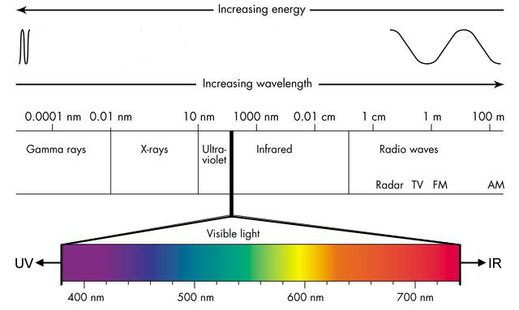
DIFFERENT COLORS OF LIGHT HAVE DIFFERENT WAVELENGTHS AND DIFFERENT ENERGIES

Slide 38
SOLAR RESOURCES
The Earth receives at an average of 1366 W/m² energy in the form of electromagnetic radiation from the Sun
This is equivalent to over 43 thousand times the entire power generation rate on the Earth
But…
Large portion of this energy is absorbed in the atmosphere.
Not available all the time at one particular place.
Needs to be collected (absorbed) before its utilization.

Slide 39
TECHNIQUES FOR USING SOLAR ENERGY
Solar energy is used in three different ways:
By converting solar energy to thermal energy through solar heater (thermal conversion)
By direct conversion of solar energy to electricity through photovoltaic (PV) approach – Most important
By converting solar energy to chemical energy (photosynthesis)

Slide 40
SOLAR ENERGY CONVERSION
To use solar energy, some part of the electromagnetic spectrum must be converted into two other farms:
Heat (Thermal Energy)
Electricity
The amount of heat or electricity produced depends upon the technology used and its efficiency.

Slide 41
ADVANTAGES AND DISADVANTAGES
Advantages
All chemical and radioactive pollutants of the thermonuclear reactions remain behind on the Sun, while only pure radiant energy reaches the Earth.
Energy reaching the earth is incredible. By one calculation, 30 days of sunshine striking the Earth have the energy equivalent of the total of all the planet’s fossil fuels, both used and unused!
Disadvantages
Solar energy is not available round the clock.
Available Solar energy is diffused. Required to be focused at one point before using (particularly for thermal conversion).
Three step approach is required:
1) collection, 2) conversion, 3) storage.

Slide 42
SOLAR THERMAL TECHNOLOGIES
Solar thermal is the oldest solar energy technology – has been used for centuries
Solar thermal technologies can be divided in three types:
Passive solar building design- Our Main building
Thermal collectors for water heating, space heating and other uses
Solar thermal power plants-similar to coal/gas based plants

Slide 43
PASSIVE SOLAR DESIGN
Passive solar design is a set of practices that accommodate the local climate by:
Letting the sun into the building in the winter
Keeping the sun out in the summer
The most important aspects of passive solar design are
Building and window orientation
Insulation and building materials
Shading

Slide 44
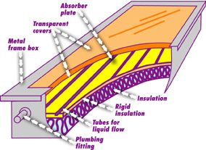
FLAT PLATE COLLECTOR (CLASSICAL DESIGN)
A flat-plate collector is used to absorb the sun’s energy to heat (mostly water).
Two methods of heating: passive (no moving parts) and active (using pumps).
In passive collectors water circulates throughout the closed system due to convection currents.
Tanks of hot water (insulated) are used for storage.

Slide 45
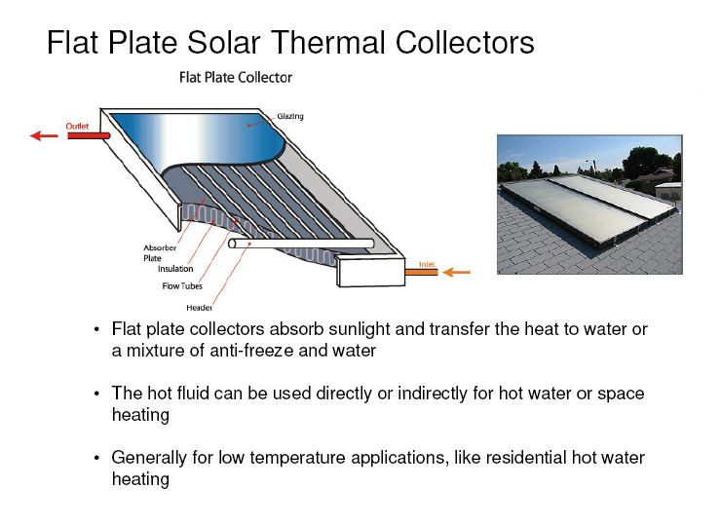
FLAT PLATE COLLECTORS (contd…)
Flat-plate solar collector absorbs sunlight and transfer the heat to water or a mixture of anti-freeze (ethylene glycol) and water
The hot fluid can be used directly or indirectly for hot water and space heating
Generally used for low temperature applications like residential hot water heating

Slide 46
EVACUATED TUBE SOLAR THERMAL COLLECTORS
Evacuated tube collectors use a “thermos bottle” type of collector that prevent freezing and can achieve higher temperatures
Used when large volumes high temperature water are needed like commercial laundries, hotels and hospitals

Slide 47
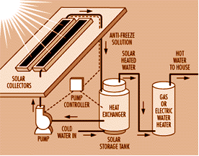
HEATING WATER: ACTIVE SYSTEM
Active System uses antifreeze so that the liquid does not freeze if outside temperature drops below freezing point.

Slide 48
DIRECT CONVERSION INTO ELECTRICITY
Photovoltaic cells are capable of directly converting sunlight into electricity.
A simple wafer of silicon with wires attached to the layers. Current is produced based on types of semiconductor (n- and p-types) used for the layers. Each cell produces 0.5 V.
Battery may be needed to store electrical energy or may be connected to grid directly through inverters.
No moving parts, no pollution, do not wear out, but because they are exposed to the weather, their lifespan is about 25 years.

Slide 49
PHOTOVOLTAIC TECHNOLOGY - BACKGROUND
The PV effect was discovered in 19th century by Alexander Becquerel
Bell labs pioneered early application, especially for satellites, in the 1960s
Very small, remote applications emerged in the 1970s and early 1980s
As cost declined, PV became more common for larger applications in late 1980s and early 1990s and now commercial usage has started world over.

Slide 50
PV CELL MATERIALS
The most common PV cells are made from crystalline silicon wafers
Other types of materials include thin films like Cadmium Telluride (CdTe), Copper-Indium-Gallium-Diselenide (CIGS), amorphous silicon (a-Si)
The main goals for manufacturers are to minimize the amount of materials and maximize efficiency
Today, the best crystalline silicon cells are about 15% efficient, the best thin films are about 8% efficient.

Slide 51
Mechanism of generation
The solar cell is composed of a P-type semiconductor and an N-type semiconductor. Solar light hitting the cell produces two types of electrons, negatively and positively charged electrons in the semiconductors.
Negatively charged (-) electrons gather around the N-type semiconductor while positively charged (+) electrons gather around the P-type semiconductor. When you connect loads such as a light bulb, electric current flows between the two electrodes.
Electrode
Reflect-Proof Film
Solar Energy
N-Type Semiconductor
P-Type Semiconductor
Load
+
-
Electric Current
+
-
-
Electrode
+
-
+
Notes:
I will introduce the principle to begin with.
Solar cell, invented in the USA in 1954, is a kind of semiconductor to convert energy of light directly into electricity. Most semiconductor used for solar cell are silicon semiconductors and it is composed of P-type semiconductor and N-type semiconductor.
Sunlight hitting the cell produces two types of electrons, negatively charged and positively charged electrons in the semiconductors. Negatively charged electrons gather around N-type semiconductor while positively charged electrons gather around P-type semiconductor.
When youconnect loads such as a light bulb or motor, electric current occurs between two electrodes.

Slide 52
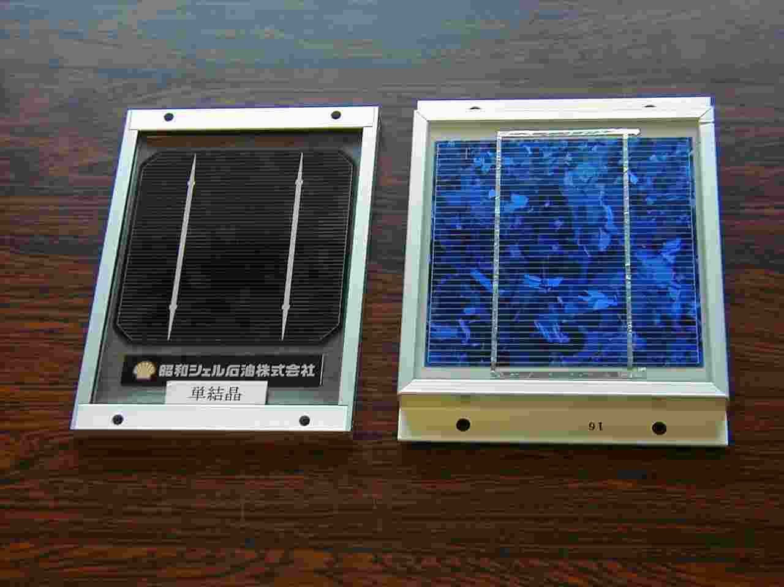
Common types of PV cell
Crystal cell (Single crystal and Poly crystalline Silicon)
Single crystal
Poly crystalline
Formed by melting high purity silicon like as Integrated Circuit
For mass production, cell is sliced from roughly crystallized ingot.

Slide 53
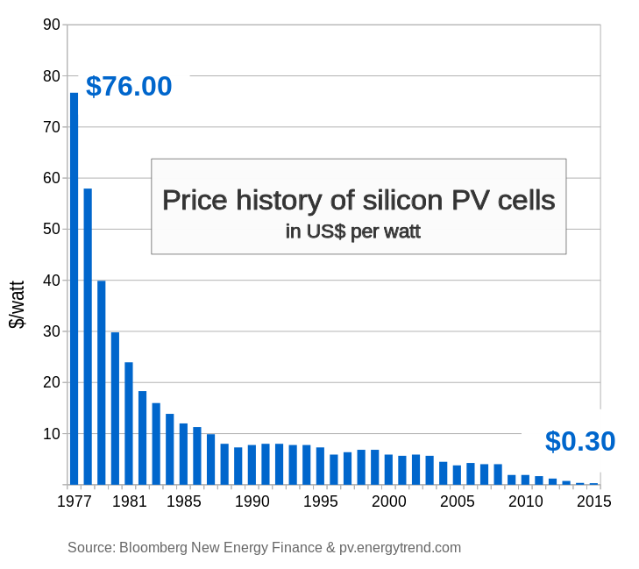
(P/H)

Slide 54

GREEN ENERGY
GENERATION@IIT ROORKEE

Slide 55
GREEN ENERGY GENERATION
SPV Power Plants/units
Solar Water Heating
Solar Heating of Swimming Pool
Solar Steam Cooking
Notes:
The various applications that our project proposes are: ***************
Here, we would like to point out that our project does not occupy any ground space of the campus which is precious

Slide 56
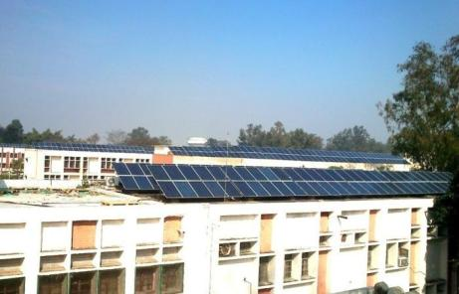
Solar Photovoltaic Electricity Roof top
Cumulative capacity | 1.819 MWp
Roof area covered | 22,000 sq m (27 buildings of all departments and units)
Technology Used | Polycrystalline Silicon
Cost of the system | Rs. 14.14 crore
First 5 year O&M cost | Rs. 13.75 lacs
O&M cost 6 to 25th year | Rs. 3.49 to 15.55 lacs per year
Unit Generation cost | Rs. 8.5 (without subsidy) Rs. 0.85 (with subsidy)
Electricity generation | 30.8 lac units annual
CO2 Reduction | 2464 ton p.a.
Contractor including O&M | Tata Power Solar
Order status | Order placed in Aug, 2013 and installation started
Date of completion | March, 2014
Global best German make string inverters
Environment monitoring system for recording parameters like Solar Radiation, Temperature and Wind speed.
SCADA (supervisory control and data acquisition) system with real-time LCD display of generation at all 27 sites.
Performance Guarantee
Generation shortfall beyond 10% of guaranteed is liquidated damage equivalent to twice of prevailing tariff.

Slide 57
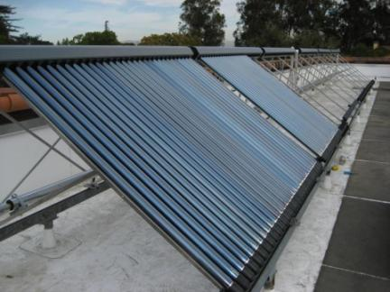
Solar Water Heating Systems
Cumulative capacity | 3.4 lacs Litres per day
Cumulative collector area | 6,794 sq. m
No. of buildings | 12 hostels, 2 guest houses 12 residential areas covering all staff
Technology | Evacuated Tube Collector
Electricity savings | 53.71 lac units per annum
CO2 Reduction | 4297 ton per annum
Current status | Working Suppliers: Tata Solar Power
Storage tank thickness more than standard for extended life.
No electrical backup, purely solar based.
Flow-meters and Temperature sensors with SCADA and LCD display
Separate Storage tank for each group of bathrooms to allow proportionate draining of water.
Performance Guarantee
Shortfall of beyond 10% of guaranteed temperature of 60 degree Celsius shall be liquidated damages

Slide 58
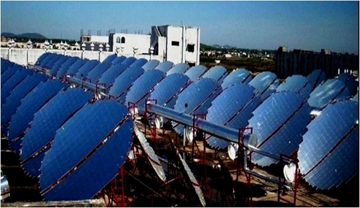
Solar steam cooking
Cumulative collector area | 976 sq. m (using 61 collectors)
No. of buildings | 9 hostel mess
Technology Used | Dish type parabolic solar concentrator
Cost of the system | Rs. 2.14 crore including steam cooking vessels
First 5 year O&M cost | Rs. 45,95,528
LPG savings | Approx 5,000 cylinders(14.2 kg) per year
CO2 Reduction | 234 ton per year
EPC Contractor | Taylormade Solutions
Status | Order placed in Oct, 2013
Completion date | April, 2014
Rice, Dal, Vegetables for about 5500 students
Steam at 10 bar pressure
Single axis automatic sun tracking parabolic dishes of 16 sq. m. area
Automatic switching system to LPG based backup on cloudy days
SCADA system for real time monitoring and data acquisition
LCD display showing all parameters
Notes:
The salient features of this system are that:
This system can be used to cook rice, dal ,vegetables…..
Images

Slide 59

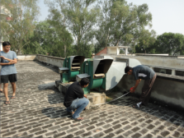
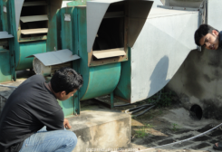

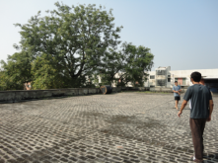
PARTICIPATION WITH STUDENTS
Students involved at all stages including:
Surveys
Measurements
Preparation of designs, drawings, estimates and DPRs
Strategies for implementation to create ownership, participation and awareness
Future leadership in green initiatives

Slide 60
Example 1
A flat plate solar thermal collector is installed on the roof of a hotel. The collection surface is 10 m². Determine the following:
(i) Power collection by surface at 11 AM, if sun insolation is 0.725 kW/m².
Power collection: 0.725*10= 7.25 kW
(ii) The water tank of the above collector contains 1200 kg of water, initially at a temperature of 34 ⁰C. What will be the temperature of water after 1 hour, assuming constant power collection as in (i) and 65% all the collected energy is being transferred to water.
Total energy in one hr = 7.25*60*60*0.65 kJ=16,965 kJ
By heat balance Q= M C_{p} delta T
Delta T= 16,965/1200/4.18= 3.38
Final Temperature of water after 1 hr: 34+3.38= 37.38 ºC
(P/H)

Slide 61
Biomass Energy

Slide 62
Biomass Energy
What is it?
Biomass energy is the use of living and recently dead biological material as an energy source
Ultimately dependent on the capture of solar energy and conversion to a chemical (carbohydrate) fuel
Theoretically it is a carbon neutral and renewable source of energy
How does work?
Traditional: forest management, using wood as fuel
Use of biodegradable waste
Examples: animal dung, crop residue, sewage, municipal solid waste
Recent interest in agricultural production of energy crops
Examples: corn, sugarcane etc.
Does not have to be a food crop
Recent interest in bioengineered (GM) plants as fuel sources
Production of a liquid or gaseous biofuel
Biogas due to the breakdown of biomass in the absence of O₂
Includes capture of landfill methane
Bioethanol from fermentation-sugarcane juice, molasses, corn, cellulosic materials
Biodiesel from nonedible oils and fats

Slide 63
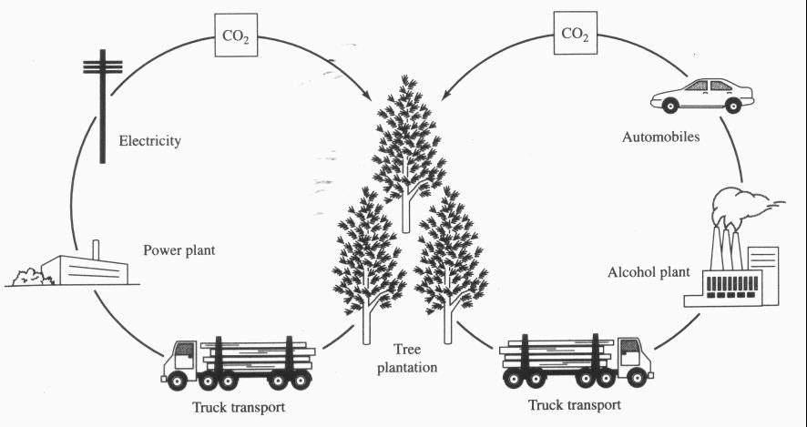
Biomass Energy
Carbon neutral
CO₂ ultimately released in energy generation is recaptured and so ideally does not change total atmospheric levels
Sequestration in soil can result in a net decrease in CO₂ levels

Slide 64
Biomass Energy
Advantages
Versatile
Renewable
No net CO₂ emissions (ideally)
Emits less SO₂ and NO_{x} than fossil fuels
Disadvantages
Low energy density/yield
In some cases (eg, corn-derived bioethanol) may yield no net energy
Land conversion
Biodiversity loss
Possible decrease in agricultural food productivity
Usual problems associated with intensive agriculture
Nutrient pollution
Soil depletion
Soil erosion
Ground water contamination

Slide 65
(P/H)
From annual report of MNRE, 2016-17

Slide 66
(P/H)
From annual report of MNRE, 2016-17

Slide 67
Example 1
(P/H)
77 grams of glucose was allowed to ferment to form ethanol and carbon dioxide. 23.4 grams of ethanol was recovered by distillation. Determine the following:
1.What is the theoretical yield of ethanol production from glucose?
2.What is the actual yield from the experiment?
Look ?
Is there any usage of CO₂ evolving in fermentation process?

Slide 68
CONCLUDING REMARKS/ ISSUES AFFECTING FUTURE DEVELOPMENT IN ENERGY SECTOR
Population & Urbanization (Developing Countries) | Stress on natural resources, lack in adequate sanitary facilities, and drainage systems, air pollution and water pollution
Health | Toxic pollutants, Impact on human health
Water Scarcity | Water Stress when water supply <1700m³/person-year Water Scarce when water supply <1000m³/person-year
Energy and Climate; Energy consumption has increased in past thirty years and projected to increase in future | Green house gas emissions, climate change, fossil fuel depletion, Increase in temperature in the next centaury: 2.4 to 6.4 ⁰C (IPCC))
Toxic Chemicals and Finite resources (non-renewable & renewable resources) | Problems associated with persistent organic pollution, trace organics (pesticides, pharmaceuticals, personal care products, endocrine disruptors)
Built Environment (buildings, roads, bridges) | High requirement of water, energy and other resources (cement, sand, clay, aggregate, steel, wood etc.)

